Slide 1



CWM Integration
Jira Integration
Agile Tool
Initiative Connectivity
DevOps Integration

Slide 2
Contents
How to create integrations (CWM , Jira , DevOps )
How to edit integrations (CWM , Jira , DevOps )
How to create integrations (CWM , Jira , DevOps ) with multiple versions

Slide 3
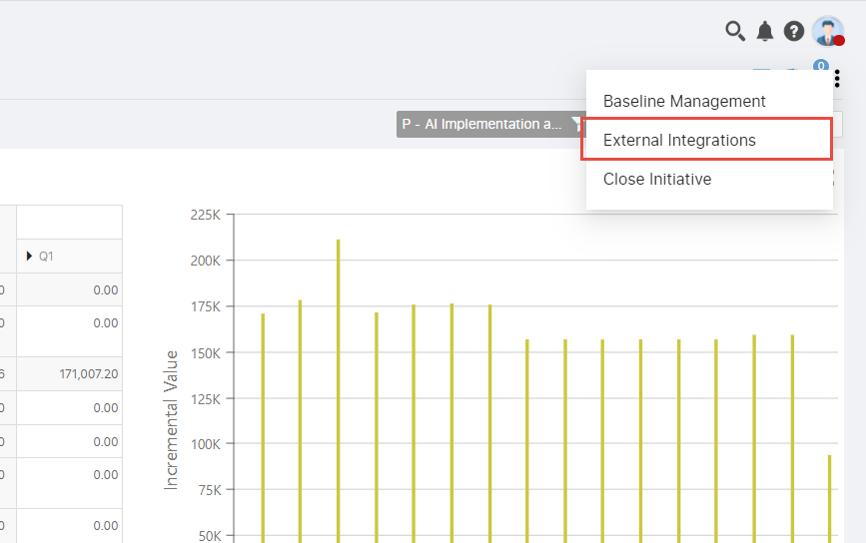
How to create integrations (CWM , Jira , DevOps )
1. Open demand workspace and click on 3dots ,we will get popup(below in screenshot) , then click ‘External Integration’

Slide 4
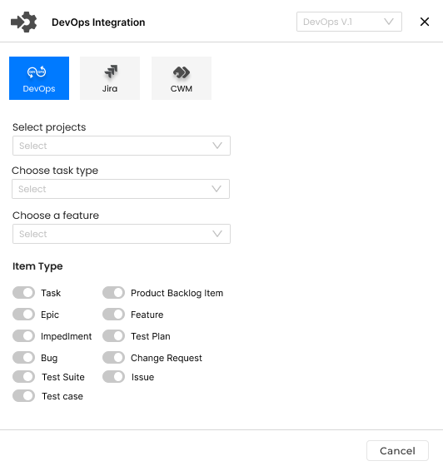
2. After clicking ‘External Integration’ , we will get below popup which contains all tabs(DevOps , Jira , CWM ).
Initially popup comes with Cancel button only.
Dynamic popup title (this title will change according to selected/active tab)
Integration tabs/options (suppose 3 tabs we have)
Connection version
Coloured background indicate selected/active tab
Initially , all switchers will come with disable value

Slide 5
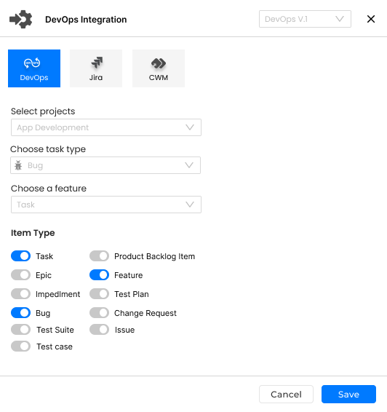
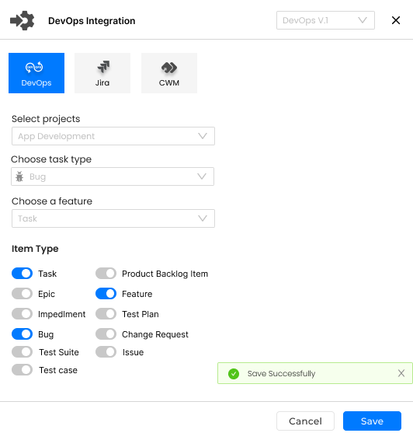
3. Save button will be visible when we are going to fill the data.
DevOps integration is saved after click on save and we will get success message.
On Save

Slide 6
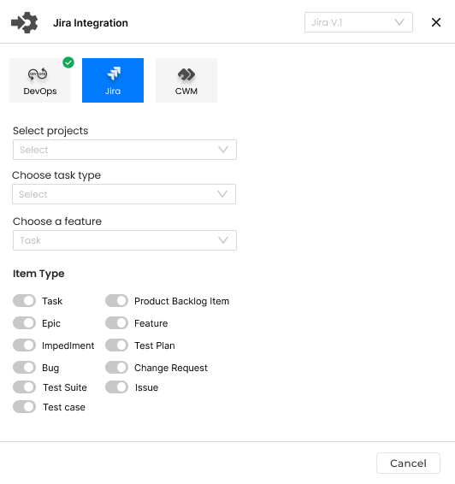
4. Now , Jira tab is active after completing DevOps. We can create Jira integration.
Initially , Only Cancel button will be visible.
Save button will be visible when filling the data.
Green checked indicates , this integration is created.

Slide 7
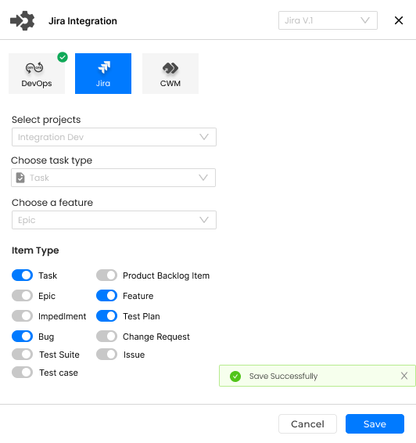
5. Jira integration is saved after filling data and click on Save button.
We will get success message after save.
success message

Slide 8
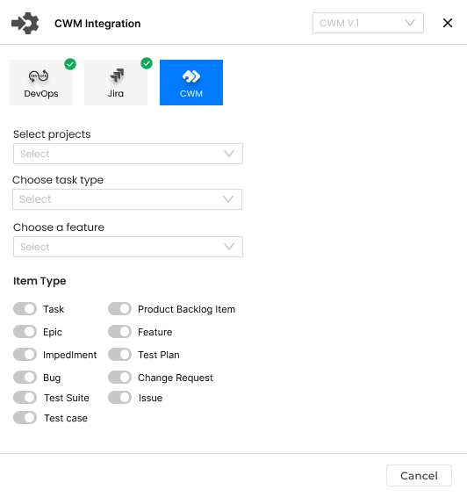
6. Now , We move on CWM Integration for creation.
Jira and DevOps have green checked indicates completed.
Save button will be visible when filling the data.
Note : We can create CWM integration like DevOps and Jira.

Slide 9
How to Edit integrations (CWM , Jira , DevOps )
Suppose , We want to edit the integration :
Select the desire tab.
After selection we will get 3 buttons Cancel , Edit and Save.
Its means , its open in read mode .
We start the editing after click Edit button.
After clicking Edit button , Edit button will be invisible , cancel and save button will be there only.
After modifying the data just click on Save button to save.
Editing process will be finished after click on save button.
See in next slide

Slide 10
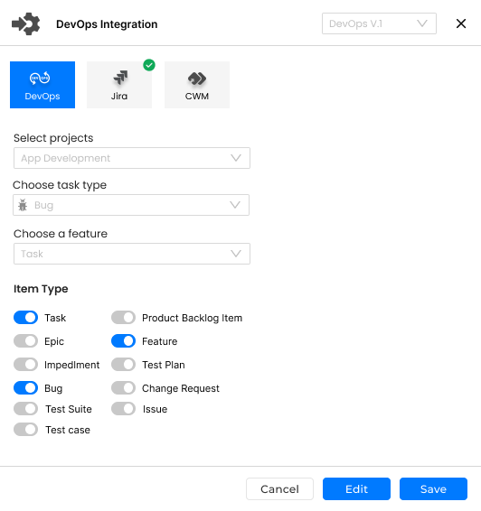
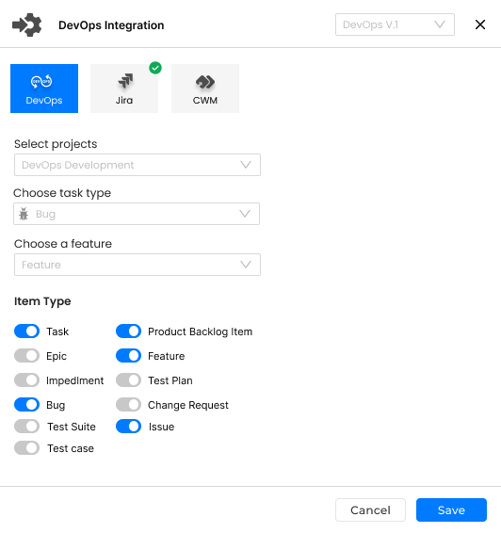
How to Edit integrations (CWM , Jira , DevOps )
Green tick mark is removed because edit inprogress
On Edit
All information are in write mode.
All information will remain in read mode until the edit button is clicked.

Slide 11
How to create integrations (CWM , Jira , DevOps ) with multiple versions
Suppose , We want to add another version of DevOps :
Select the version from version dropdown which is placed in right side of popup header.(see in screenshot)
After select new version , all fields od DevOps come in initial state(like first time creation)
Only Cancel button will be there.
Save button will be visible on filling the fields.
DevOps integration creation done with version after click on save button.
See in next slide
Note : We can create more version in same ways for other integration.

Slide 12
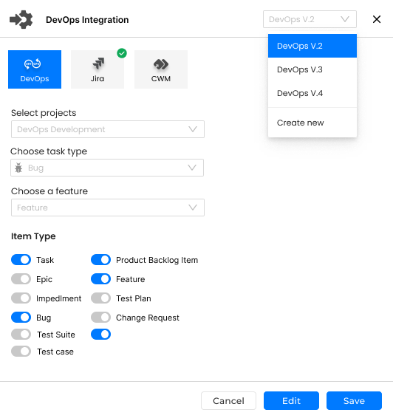
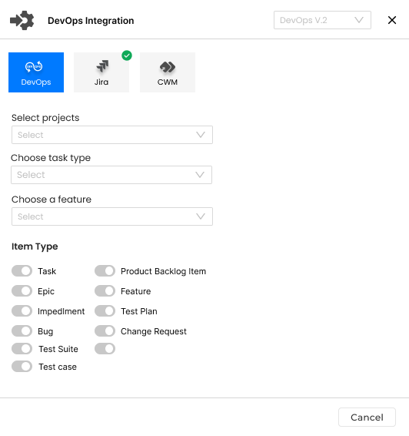
How to create integrations (CWM , Jira , DevOps ) with multiple versions
On Change version

Slide 13
Thank You

